Slide 1
Radio Frequency Signal Generator
By: Ethan Cura, Abel Gonzalez, Joseph Hinz and James Taylor
Notes:
James

Slide 2
Purpose
The goal of this project is to supplement the existing market with a low-cost RF signal generator for students and enthusiasts.
Notes:
James

Slide 3
Technical Summary
The signal generator shall have a frequency range between 1 and 500MHz with 1Hz precision.
The signal generator shall be able to frequency and amplitude modulate this carrier frequency.
The signal generator shall minimize any spurious signals for a spectrally pure output.
Notes:
Abel

Slide 4
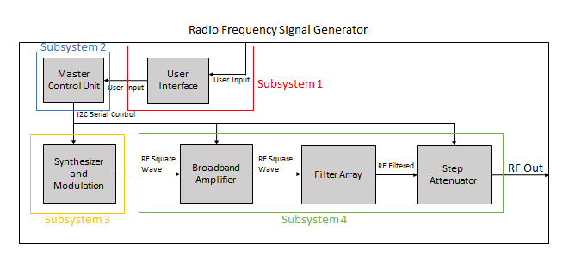
System Overview
Subsystem 1: Ethan Cura
Subsystem 2: Abel Gonzalez
Subsystem 3: Joseph Hinz
Subsystem 4: James Taylor
Notes:
Ethan

Slide 5
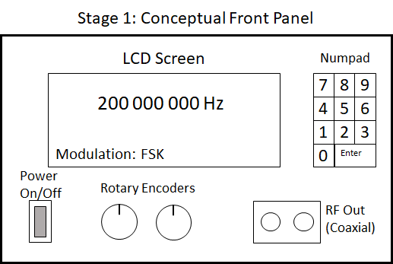
Subsystem 1: User Interface

Slide 6
Subsystem 1: Integration Goals
Buy a simple metal housing to mount instruments
Split UI into 2 boards(UI board/MCU board) for easier integration
Redesign UI board to allow UI elements to mount to the front panel
Design MCU board that interfaces with the LaunchpadXL and connect the MCU board to the UI board and all subsystems
Design the MCU board to distribute power to all other boards

Slide 7
Subsystem 1: Integration Progress
A metal housing has been purchased and delivered
The designs for the MCU board and the UI board have been completed and sent out for fabrication
Boards are expected to arrive in the next few days
Parts for both boards have arrived
Case fitting/mounting will begin once the boards have arrived and been assembled

Slide 8
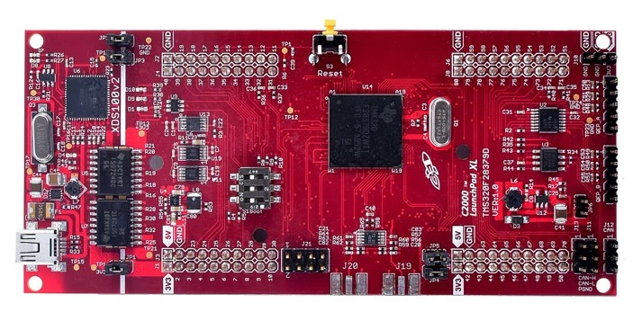
Subsystem 2: Master Control Unit
Notes:
Controls the synthesizer, modulation, filter selection, and appropriate attenuation
Abel

Slide 9
Subsystem 2: Integration Goals
Develop code that will allow the MCU to interface with digital I/O such as the rotary encoders and numpad
Develop code that will allow the MCU to communicate/control I2C components such as the character display and synthesizer
Develop a menu that allows the user to control the completed device through the UI

Slide 10
Subsystem 2: Integration Progress
Basic control code has been developed to read and write to pins
Basic I2C control code has been developed and tested successfully on real components
Code has been developed to add pins to interrupt groups and connect these groups to interrupt service routines
Further development is needed to communicate with rotary encoders and numpad. I2C communication with Si570 synthesizer still needs to be developed.

Slide 11
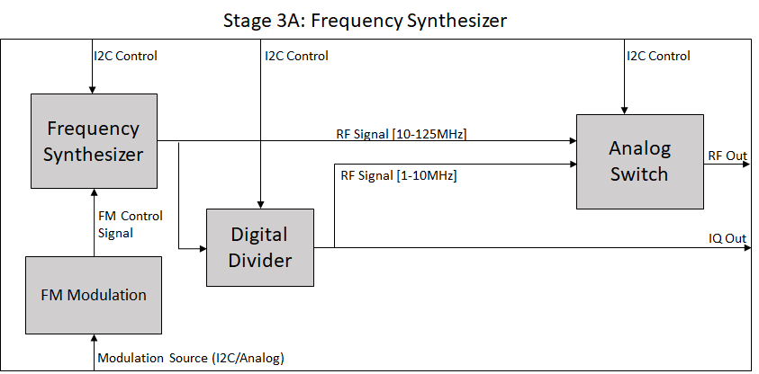
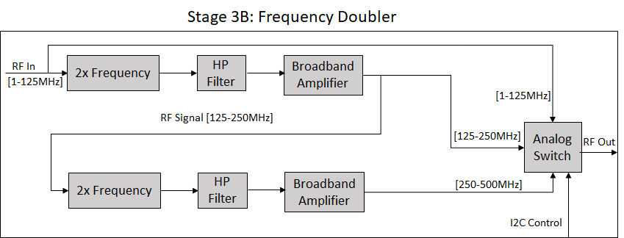
Subsystem 3: Synthesizer and Modulation
Notes:
Joe

Slide 12
Subsystem 3: Integration Goals
Subsystem 3 will be controlled via I2C through a ribbon cable from the MCU board
Power will also be supplied from the MCU board
The output of subsystem 3 will be passed to Subsystem 4 through a coaxial cable

Slide 13
Subsystem 3: Integration Progress
At this point Subsystem 3 works as intended
Communication through I2C has been tested successfully using a different MCU control board (Arduino)
Output signal from Subsystem 3 through a coaxial cable has been successfully tested
Power connection to MCU board will be accomplished using two jumper wires connected to the MCU board.

Slide 14
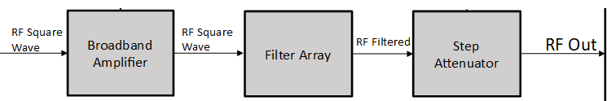
Subsystem 4: Broadband Amplifier/Filter Array/Step Attenuator
Amplifier increases the power of the carrier/modulated signal
Filters remove unwanted harmonics from square wave signal to produce a sinusoidal carrier
Attenuators reduce signal power to the user defined output power
Notes:
James

Slide 15
Subsystem 4: Integration Goals
Subsystem 4 will be controlled via I2C through a ribbon cable from the MCU board
Power will also be supplied from the MCU board
The output of subsystem 4 a coaxial terminal

Slide 16
Subsystem 4: Integration Progress
Amplifier and filter boards (but not the attenuator board) have been fabricated
Two filter boards assembled, and so far are working as expected
Amplifier board short is due to a problem in the PCB itself (probably damage during soldering process), will need to re-order and re-solder components. Spare PCB is unaffected.
Filter board 3 components delayed due to winter storm, will be soldering this week.
Working on attenuator board schematic, goal is to have the board sent out for fabrication sometime this weekend
3.3V vs. 5V logic
Notes:
James

Slide 17
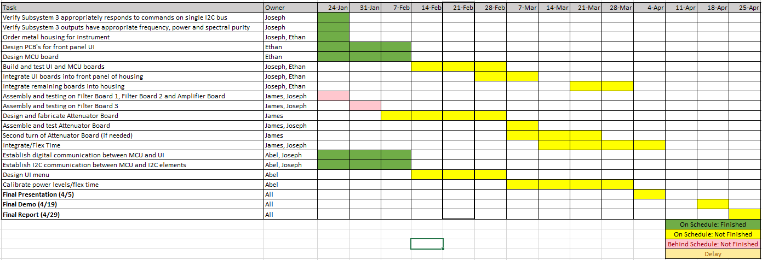
Integration Timeline

Slide 18
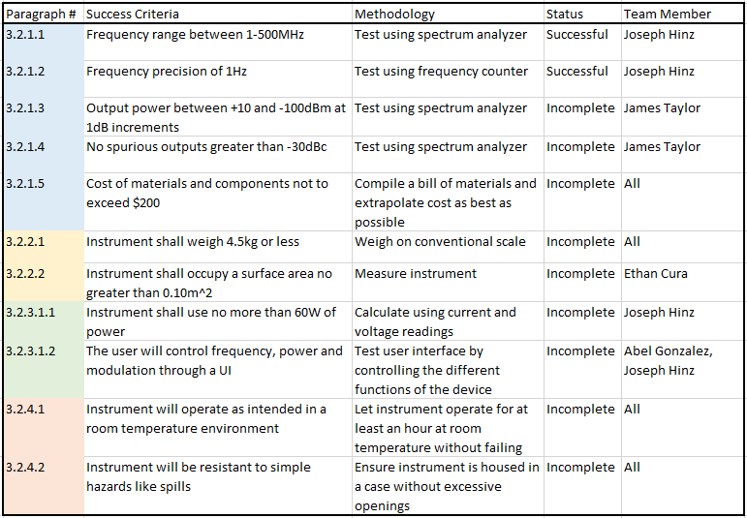
Validation Plan

Slide 19
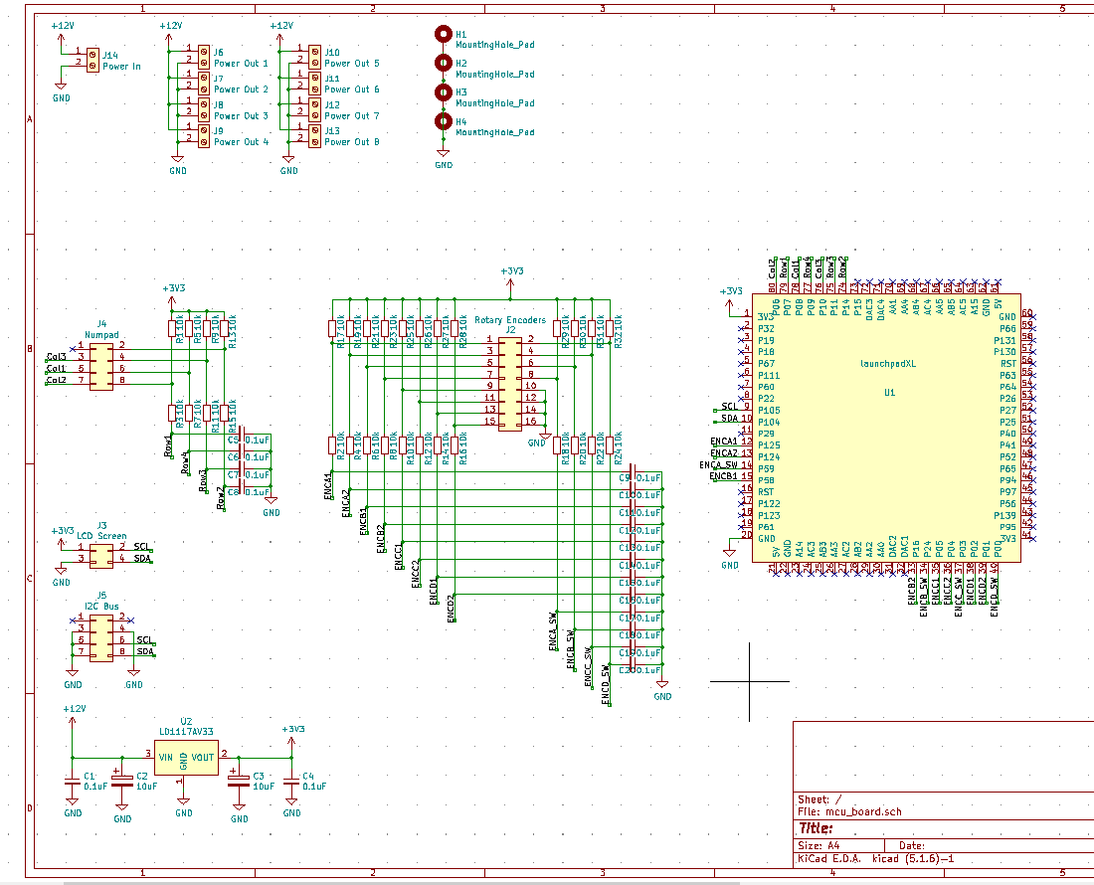
Subsystem 1: MCU Board Schematic

Slide 20
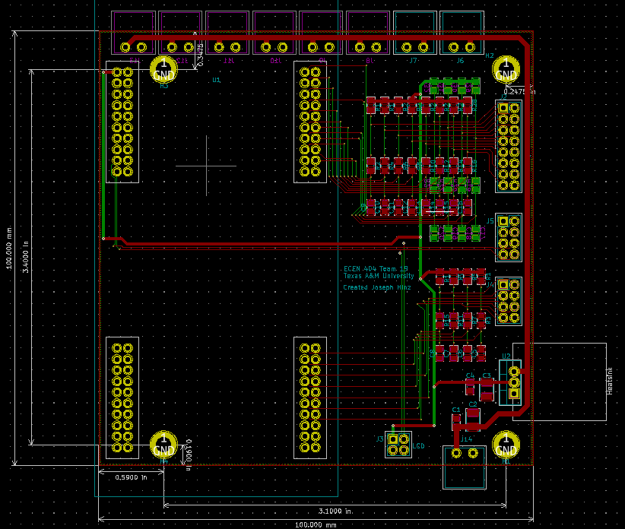
Subsystem 1: MCU Board Layout

Slide 21
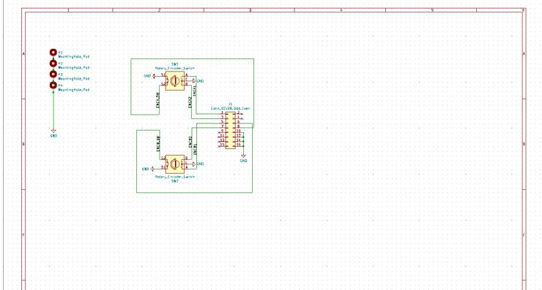
Subsystem 1: UI Board Schematic

Slide 22
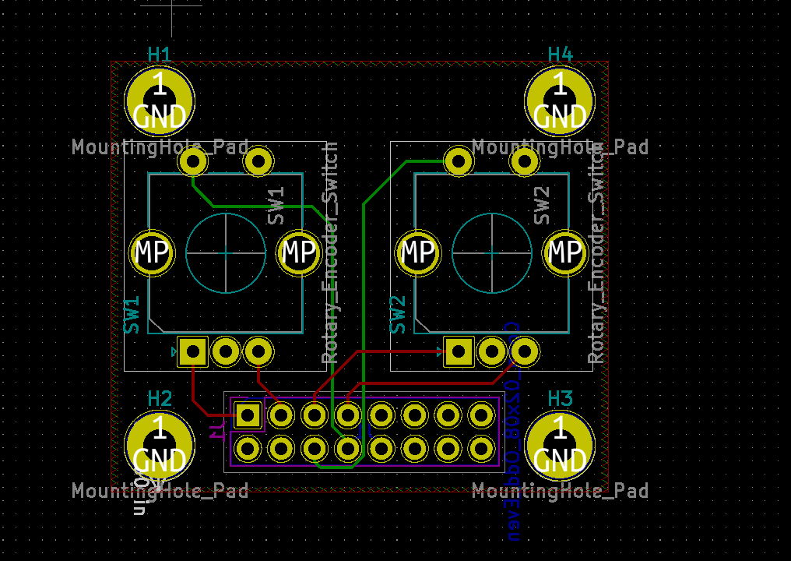
Subsystem 1: UI Board Layout

Slide 23
Questions

Slide 24
Thank You

